Slide 1
Escalation Management Module
Alabado, Matthew Arnold
Alconcel, Alanis Watz
Balubal, Samantha Nicole
Brillantes, Rachel Anne
Burton, Kathrine Danielle
Pamittan, Engel-Jan

Slide 2
OVERVIEW
Introduction

Slide 3
INTRODUCTION
Client: Taal Vista Hotel
Problems:
Unattended service requests
Limited escalation process
Solutions:
Escalation process
Escalation reports

Slide 4
OVERVIEW
Introduction
Objectives

Slide 5
OBJECTIVES
GENERAL OBJECTIVE:
Develop a solution for Quality Assurance Department for Taal Vista
Escalation Reports
Notes:
To develop a solution for the Quality Assurance Department of Taal Vista Hotel that will produce effective Escalation Reports from the gathered complaint and escalation data

Slide 6
OBJECTIVES
SPECIFIC OBJECTIVES
Develop an Escalation Management Module
Gather escalation data
Formulate a forecast from Escalation Reports
Decrease numbers of escalation
Notes:
To develop a solution for the Quality Assurance Department of Taal Vista Hotel that will produce effective Escalation Reports from the gathered complaint and escalation data

Slide 7
OVERVIEW
Introduction
Objectives
Related Systems

Slide 8
RELATED SYSTEMS
SYSTEM NAME | COMMON FEATURES | UNIQUE FEATURES
KNOWCROSS (KnowGlitch) | Real-Time Communication | Hotel Management Software
MANAGEENGINE SERVICEDESK PLUS | Ticketing System Real-Time Communication Skills-Based Dispatching | Email to Ticket Conversion Manage and Track all incidents
HOTELTAP | Real-Time Communication | Analytic Dashboards Text Messaging Communication Hotel Process Overview for hotel clients

Slide 9
RELATED SYSTEMS
SYSTEM NAME | COMMON FEATURES | UNIQUE FEATURES
FCS COMPUTER SYSTEMS (GUEST SERVICES) | Mobile-Enabled Task Escalation | Smart Escalation Intelligent job assignment
ALICE (CONCIERGE) | Mobile-Enabled Ticketing System Task-Tracking System | Accessibility of To-Do List through mobile devices (for the staff)
BUTLERPAD | Smart Data (Task Escalation) | Cloud-based Effective communication technology
Notes:
Allows the staff to have access to their to-do lists through their mobile devices.

Slide 10
RELATED SYSTEMS
SYSTEM NAME | COMMON FEATURES | UNIQUE FEATURES
GESS (Guest Experience Software System) | Mobile-Enabled Task Escalation | Automatic alert that notifies the employees
HOTELMGR | Mobile-Enabled Skill-Based Dispatching Task-Tracking System | Multilingual Workflow Management Request Prioritization
ORACLE ESCALATION MANAGEMENT | Task-Tracking System | Service Request and Task-Linking Capability Ownership assignment De-escalation & closure Automatic notification (Escalation Progress)

Slide 11
OVERVIEW
Introduction
Objectives
Related Systems
Comparison of Existing and Proposed System

Slide 12
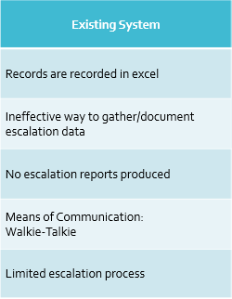
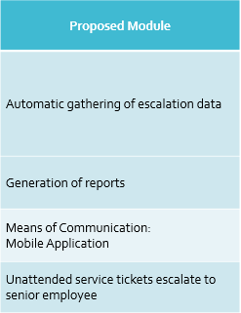
EXISTING SYSTEM vs. PROPOSED SYSTEM
Notes:
Limited escalation process
limited to just directly reporting it to the immediate supervisor with no documentation.
Existing System
Proposed Module
Records are recorded in excel
Automatic gathering of escalation data
Ineffective way to gather/document escalation data
No escalation reports produced
Generation of reports
Means of Communication:
Walkie-Talkie
Means of Communication:
Mobile Application
Limited escalation process
Unattended service tickets escalate to senior employee

Slide 13
OVERVIEW
Introduction
Objectives
Related Systems
Comparison of Existing and Proposed System
Proposed System (Diagrams)
Proposed Systems Overview

Slide 14
DIAGRAMS
Escalation Management Module
Context Flow Diagram
Data Flow Diagram
Use Case Diagram
Package Diagram
Activity Diagram
State Machine Diagram
Sequence Diagram
Communication Diagram
Component Diagram
Deployment Diagram
Entity Relationship Diagram
Class Diagram
Object Diagram
Interaction Overview Diagram

Slide 15
SYSTEMS OVERVIEW
Receive: Unattended service tickets
Escalation Type: Automatic – based on time
Hierarchy Levels of Escalation
Level 1 – Supervisor (SUP)
Level 2 – Department Manager (DM)
Level 3 – Resident Manager (RM)
Level 4 – General Manager (GM)
Notes:
Receive: Unattended service tickets
Unattended service tickets from Service Recovery and Reports System Manually escalated tickets from Receptionist
Types of Escalation
Automatic – based on time
Manual – based on situation
Levels of Escalation
Level 1 – Supervisor (SUP)
Level 2 – Department Manager (DM)
Level 3 – Resident Manager (RM)
Level 4 – General Manager (GM)

Slide 16
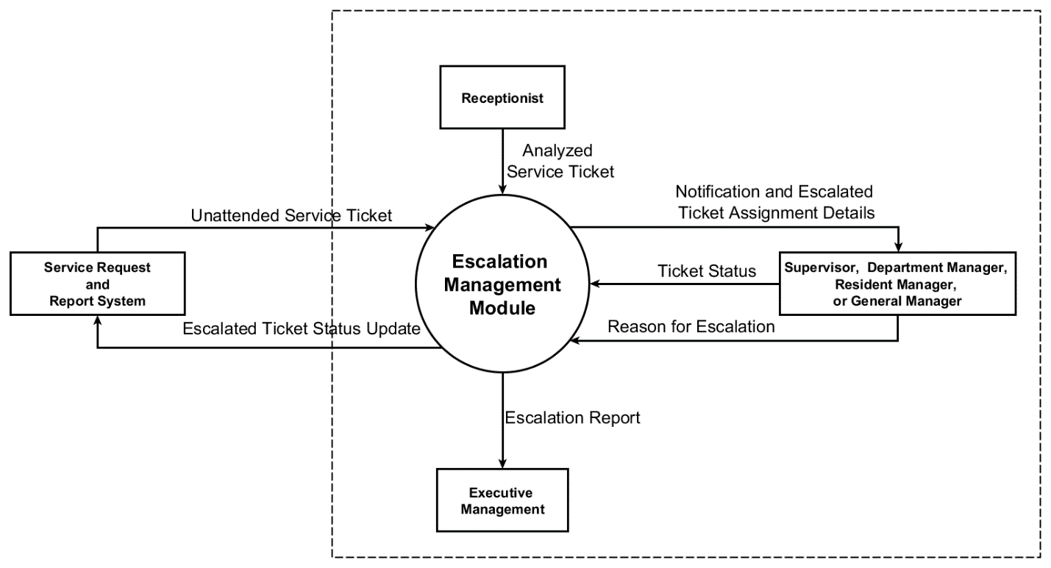
CONTEXT FLOW DIAGRAM

Slide 17
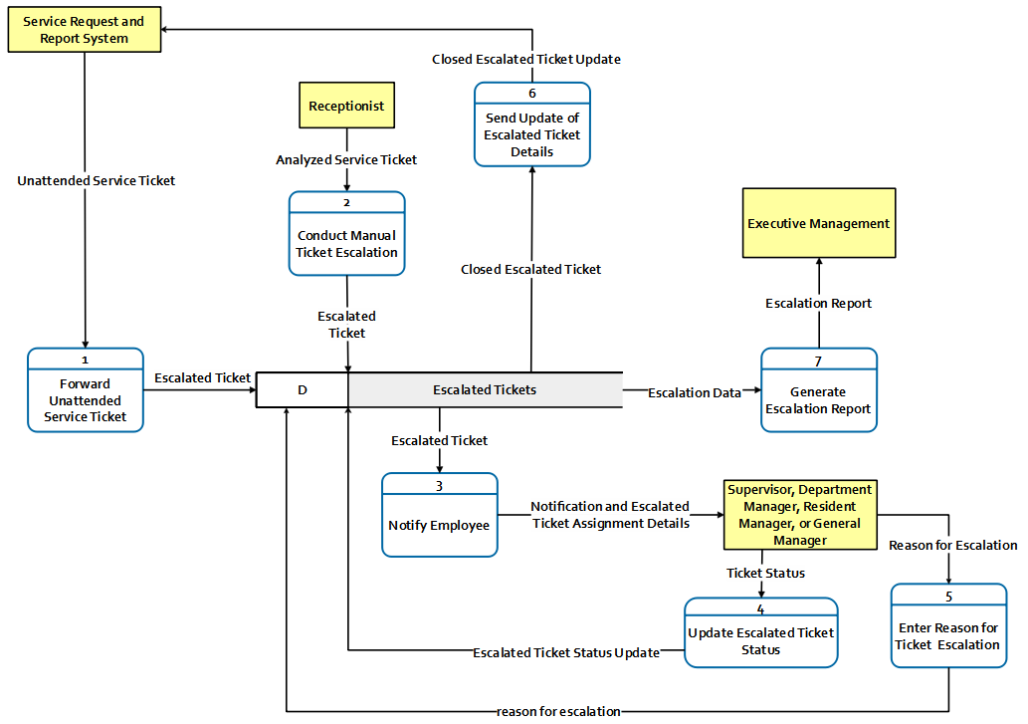
DATA FLOW DIAGRAM
(Level 0)

Slide 18
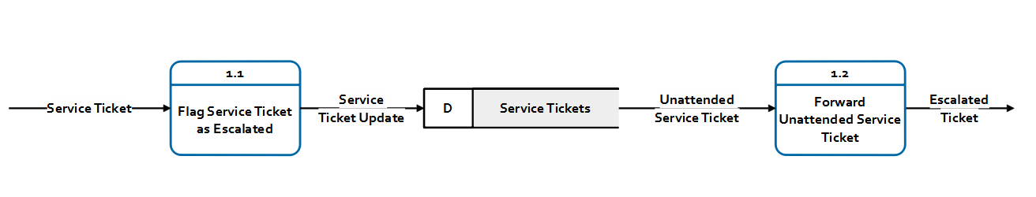
DATA FLOW DIAGRAM (Level 1 – Process 1)

Slide 19
DATA FLOW DIAGRAM
(Level 0)

Slide 20
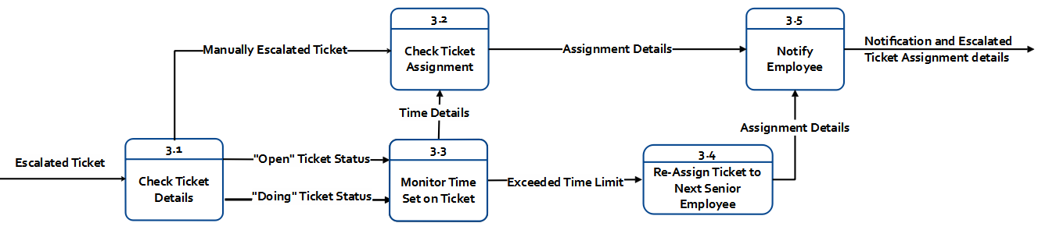
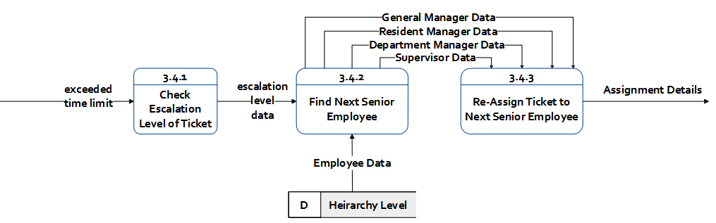
DATA FLOW DIAGRAM
(Level 1 – Process 3)
(Level 2 – Process 3)

Slide 21
DATA FLOW DIAGRAM (Level 0)

Slide 22
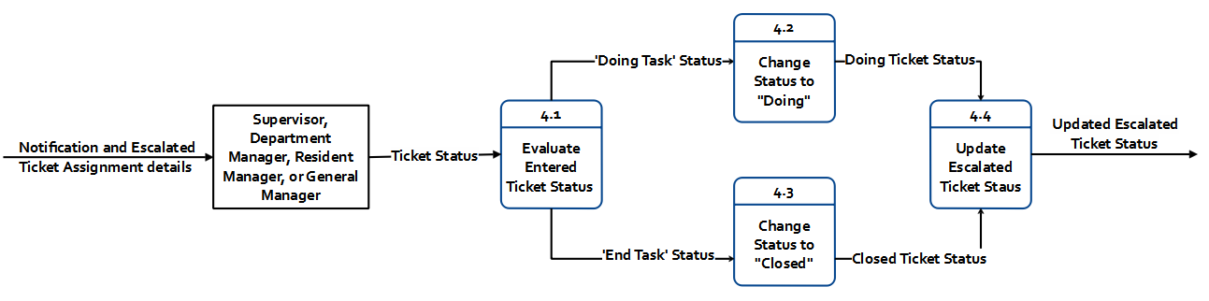
DATA FLOW DIAGRAM (Level 1 – Process 4)

Slide 23
DATA FLOW DIAGRAM
(Level 0)

Slide 24
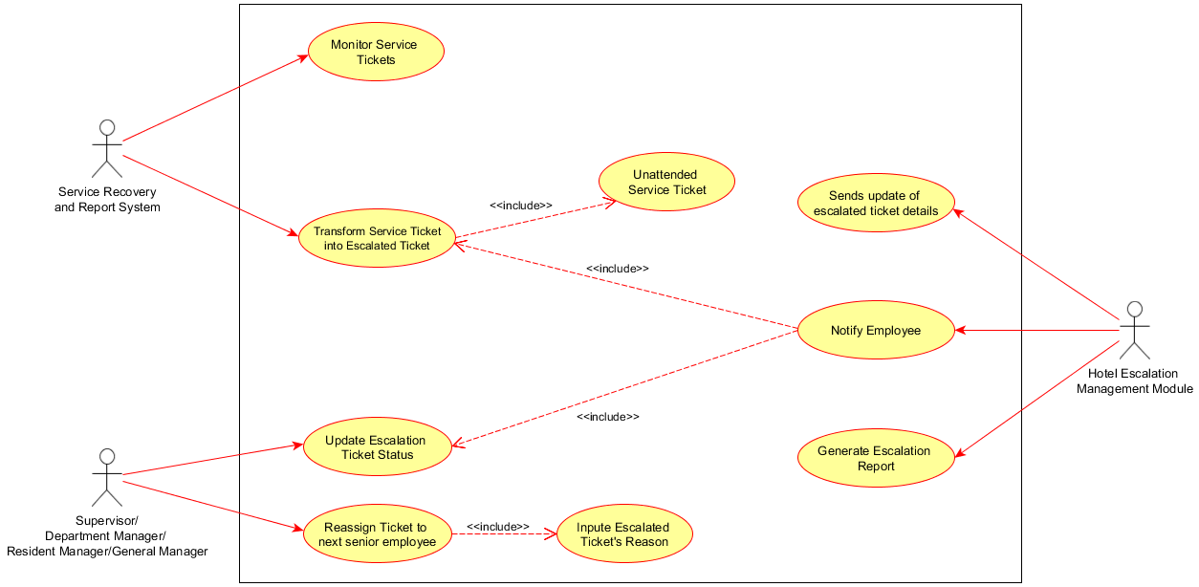
USE CASE DIAGRAM

Slide 25
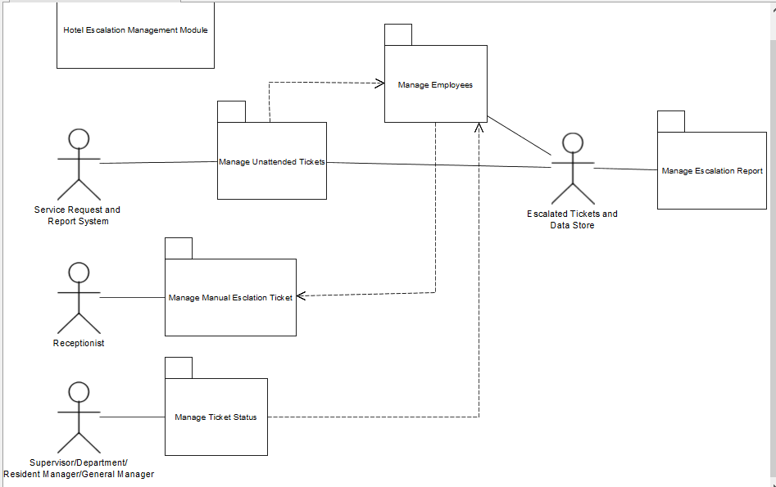
PACKAGE DIAGRAM

Slide 26
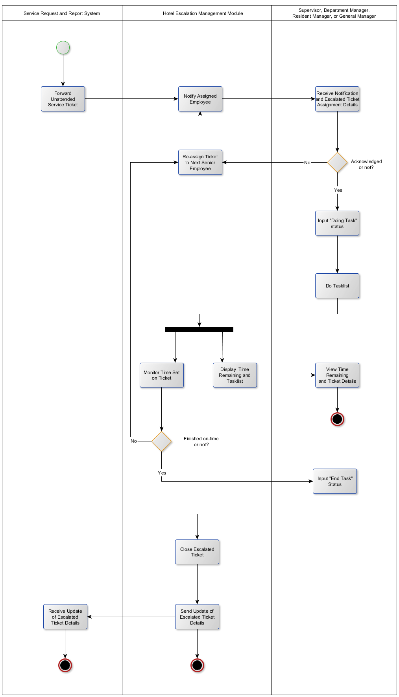
ACTIVITY DIAGRAM (Service Recovery and Report System – Higher level Employee )

Slide 27
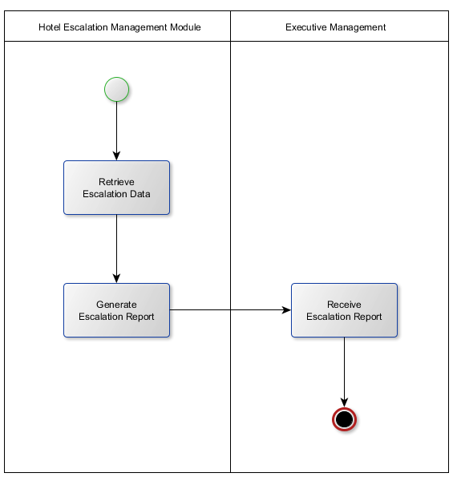
ACTIVITY DIAGRAM (Generation of Escalation Report)

Slide 28
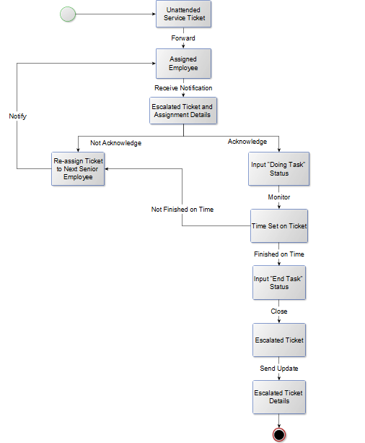
STATE MACHINE DIAGRAM

Slide 29
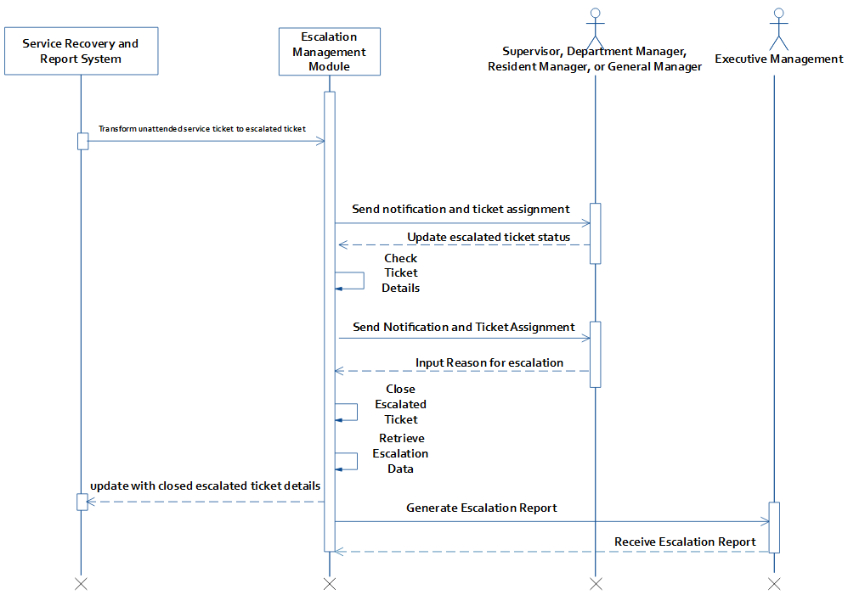
SEQUENCE DIAGRAM

Slide 30
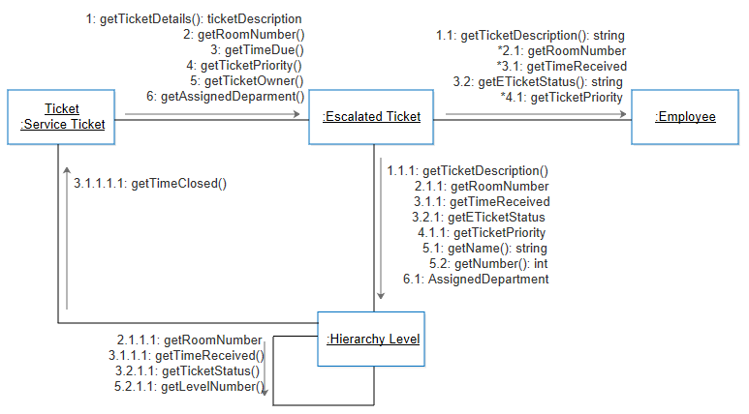
COMMUNICATION DIAGRAM

Slide 31
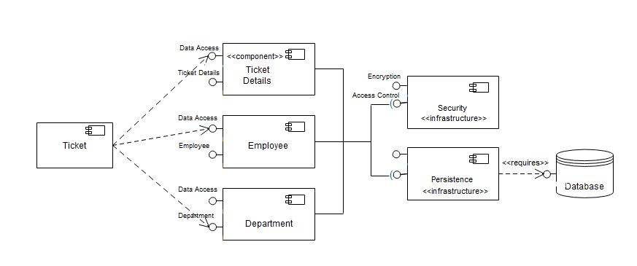
COMPONENT DIAGRAM

Slide 32
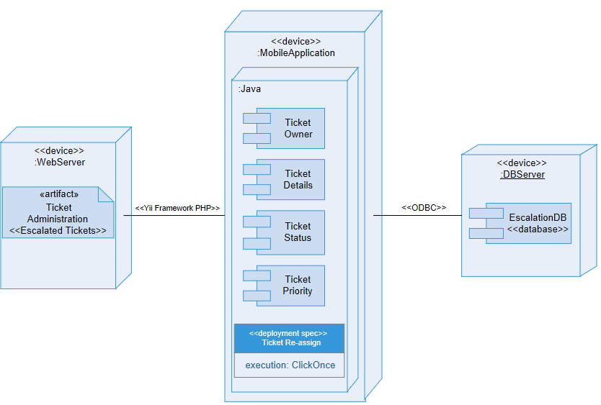
DEPLOYMENT DIAGRAM

Slide 33
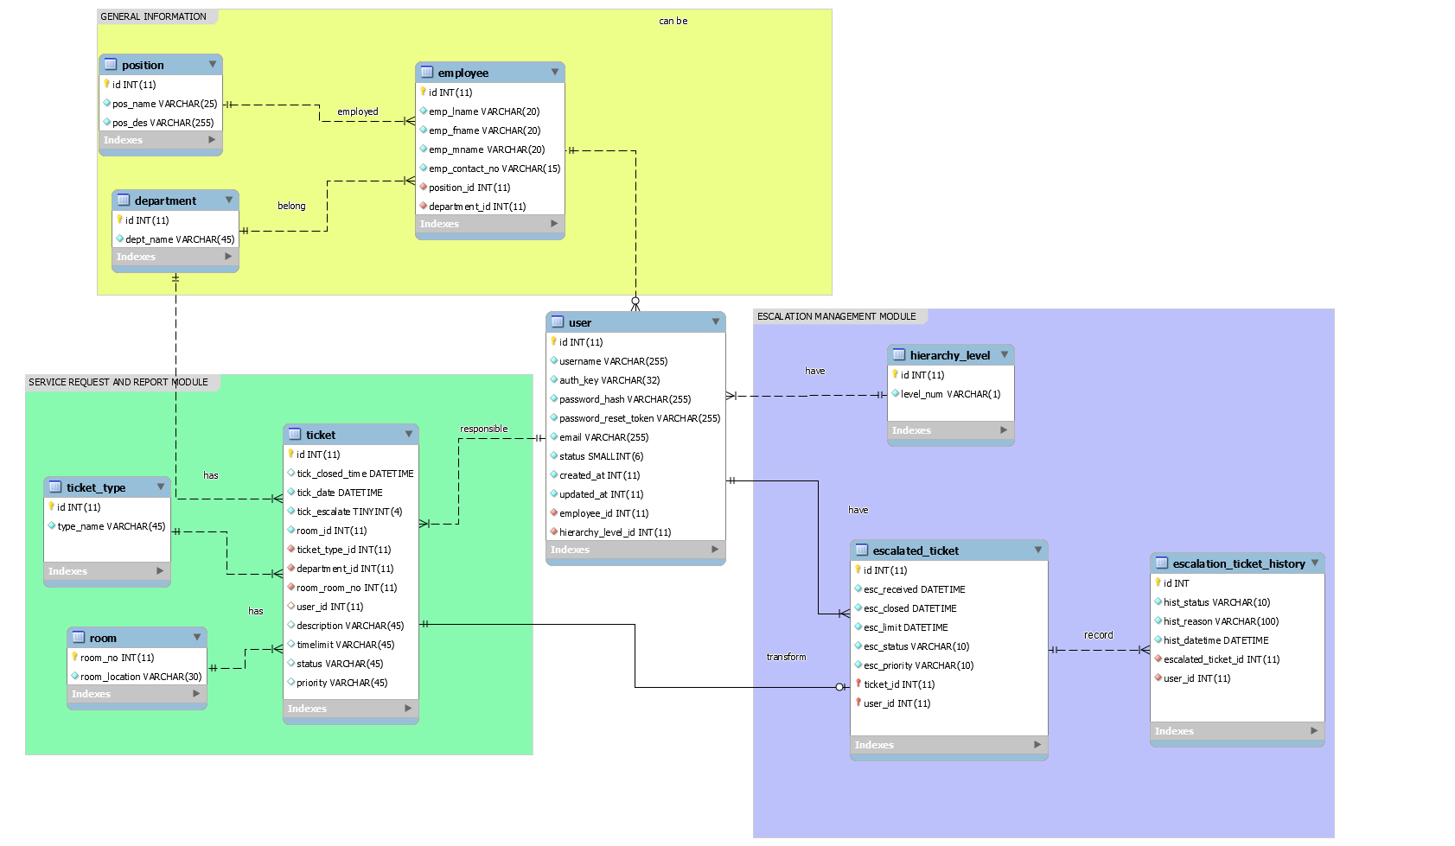
ENTITY RELATIONSHIP DIAGRAM

Slide 34
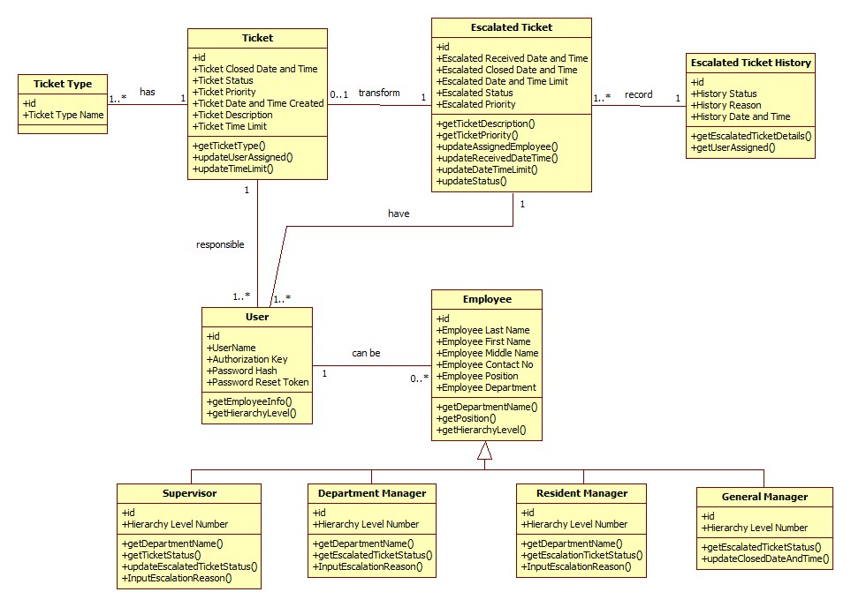
CLASS DIAGRAM

Slide 35
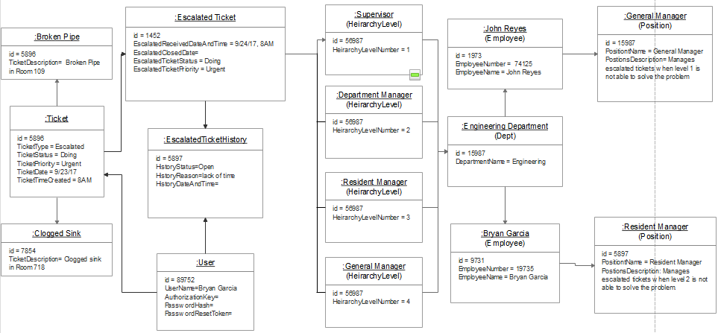
OBJECT DIAGRAM

Slide 36
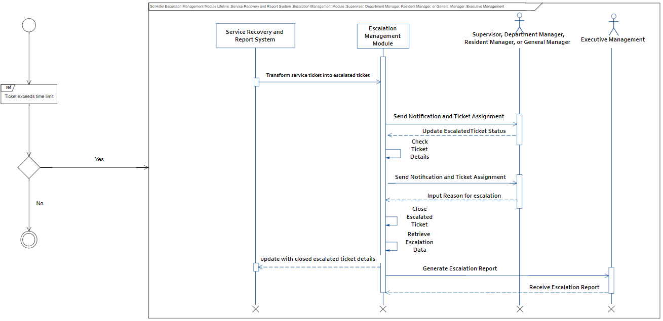
INTERACTION OVERVIEW DIAGRAM

Slide 37
END

Slide 38
Instances for Manual Escalation | Example
Request not part of inventory Requires 3rd party assistance Long Term Engineering Issues | Nebulizer, Wheelchair, Breast Pump Internet, Cable TV, Water Supply, Brownout Broken Pipe, AC Unit Replacement, Broken Furniture

